Slide 1
NETWORKING
PALANIVEL

Slide 2
Basics of Networking
2018
A network is a collection of computing devices.
These devices communicate by exchanging data over a wired or wireless medium
Types of Networks
Local Area Network (LAN)
Metropolitan Area Network (MAN)
Controller Area Network (CAN)
Wide Area Network (WAN)

Slide 3
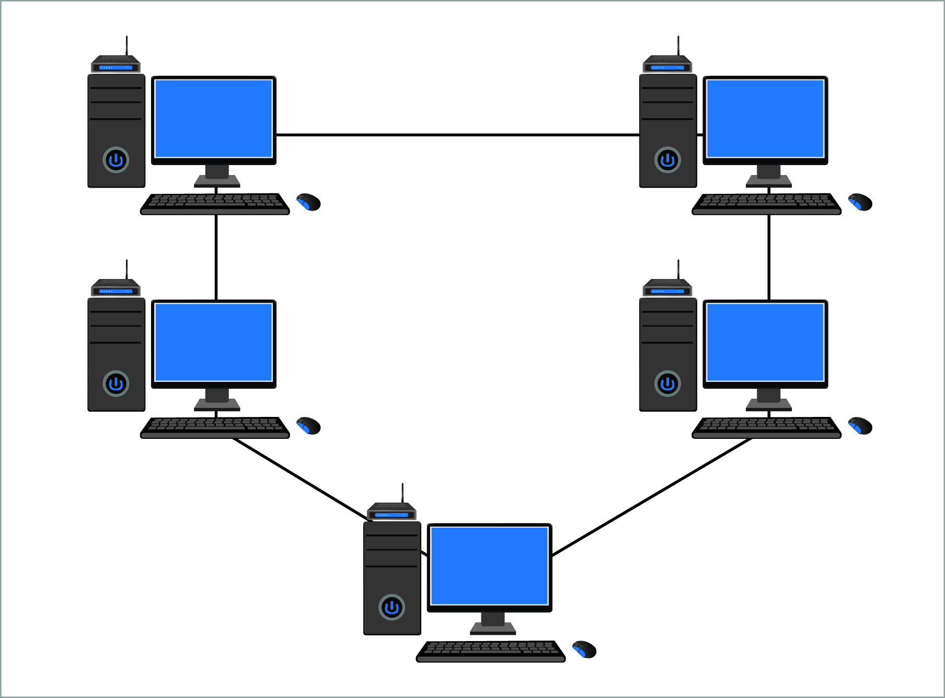
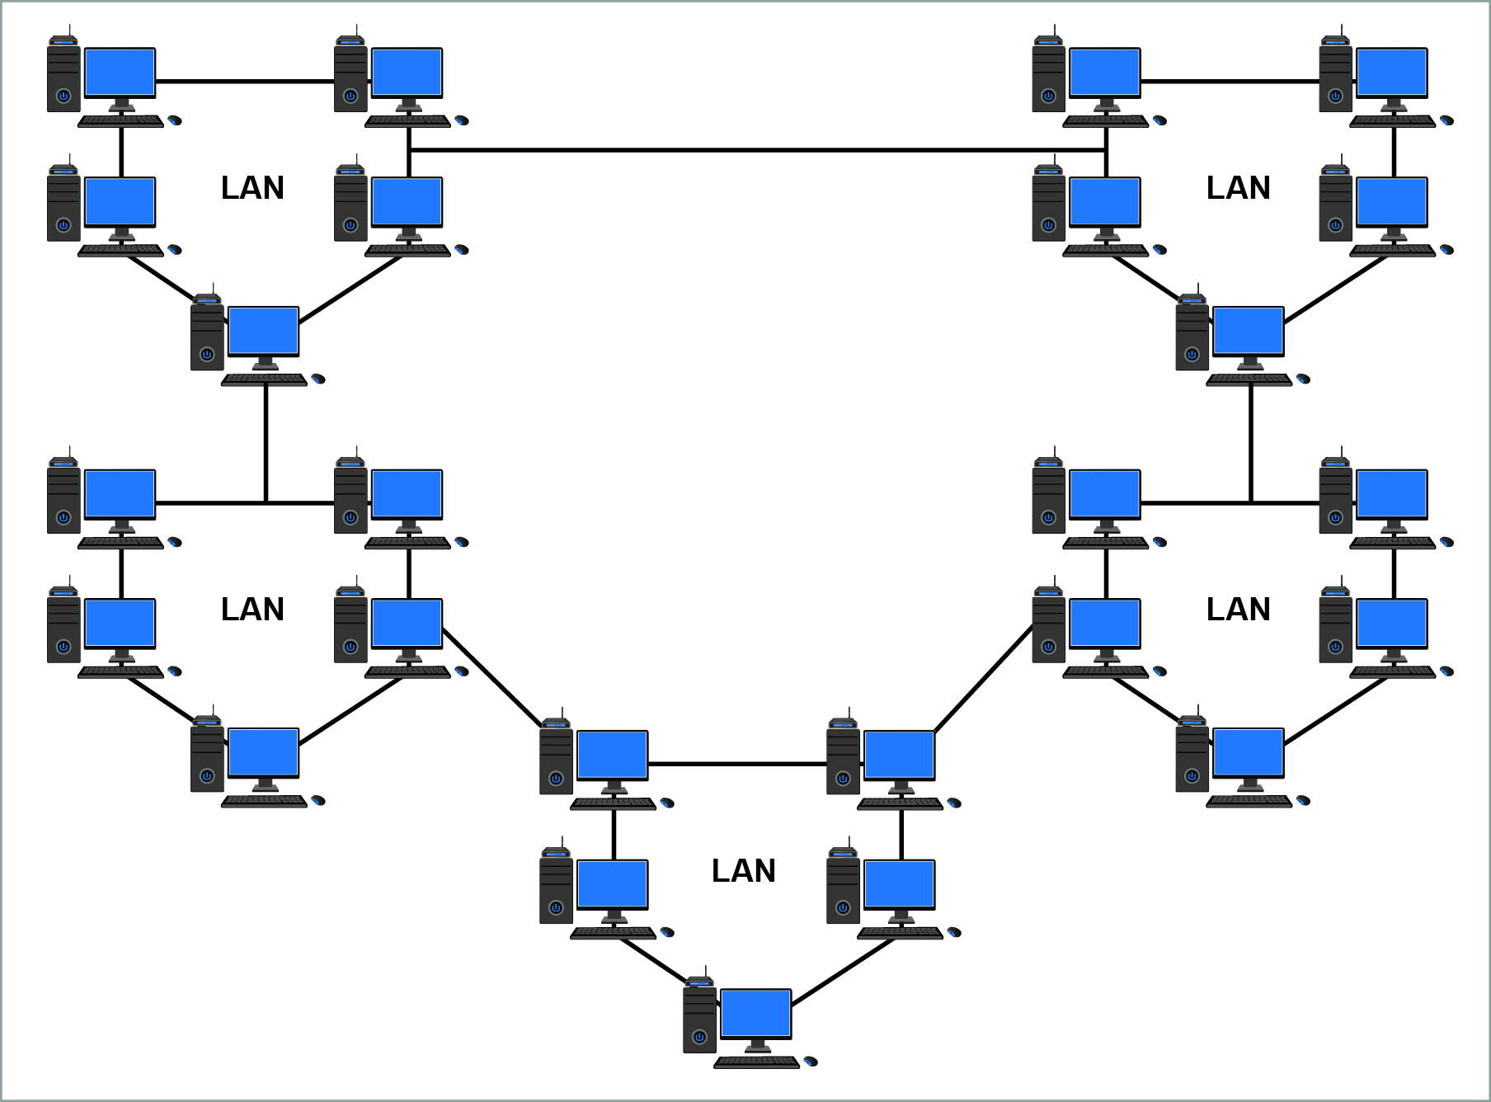
2018
Types of Networks
LAN
WAN

Slide 4
2018
Coaxial cable
Copper media
STP
Twisted pair
Wired
UTP
Step index fiber
Fiber optic cables
Graded index fiber
Transmission Media
Radio wave
Wireless
Infrared
Microwave

Slide 5
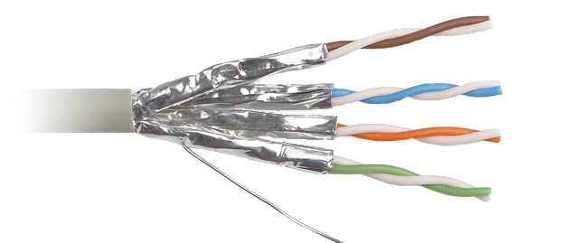
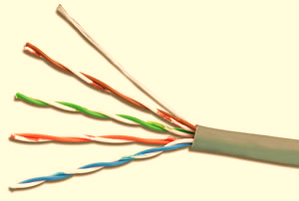
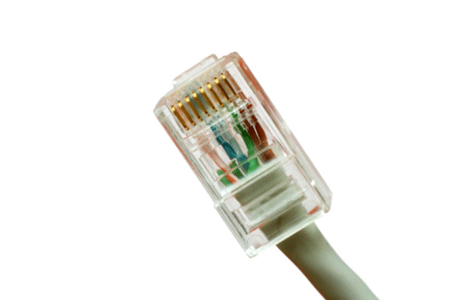
STP
UTP
RJ45

Slide 6

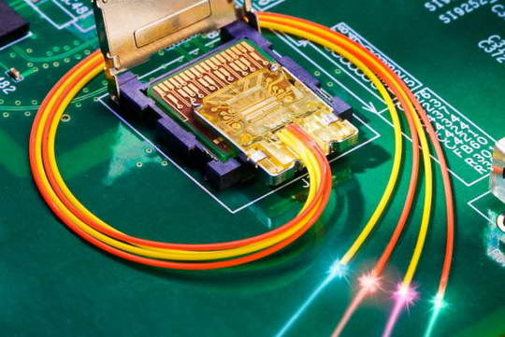
Fiber Optic Cable

Slide 7
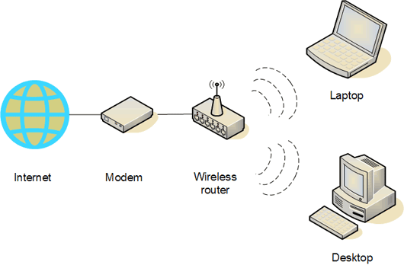
Wireless Media

Slide 8
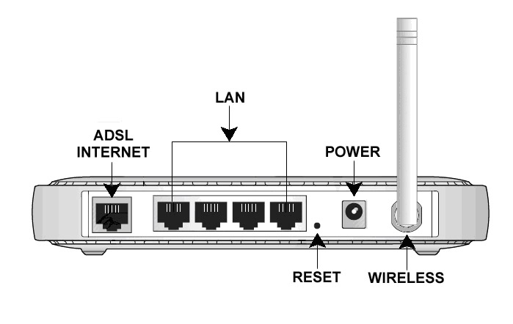
2018
Wireless Access Point (WAP)

Slide 9
The IEEE 802.11 standard is dedicated to wireless LANs
Standard | Speed of Transmission | Distance or Geographic Range | Frequency
802.11 | 2 Mbps | 20 meters | 2.4 GHz
802.11a | 54 Mbps | 50 meters | 5 GHz
802.11b | 11 Mbps | 100 meters | 2.4 GHz
802.11g | 54 Mbps | 100 meters | 2.4 GHz
802.11n | 600 Mbps | 70 meters | 2.4 GHz or 5 GHz

Slide 10
Common LAN connectivity devices are:
NIC
Switch
Router
Repeater
Hub
Bridge
Firewall

Slide 11
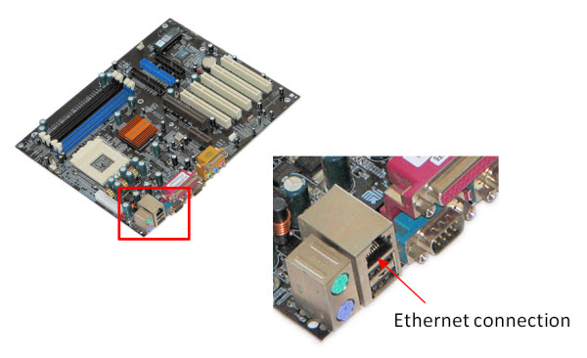
NIC (Network Interface Card)
2018

Slide 12
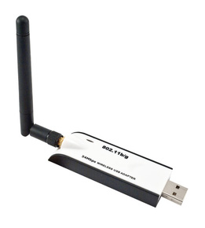
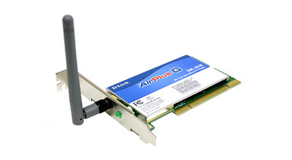
Wireless NIC
2018
USB
Adapter Card

Slide 13
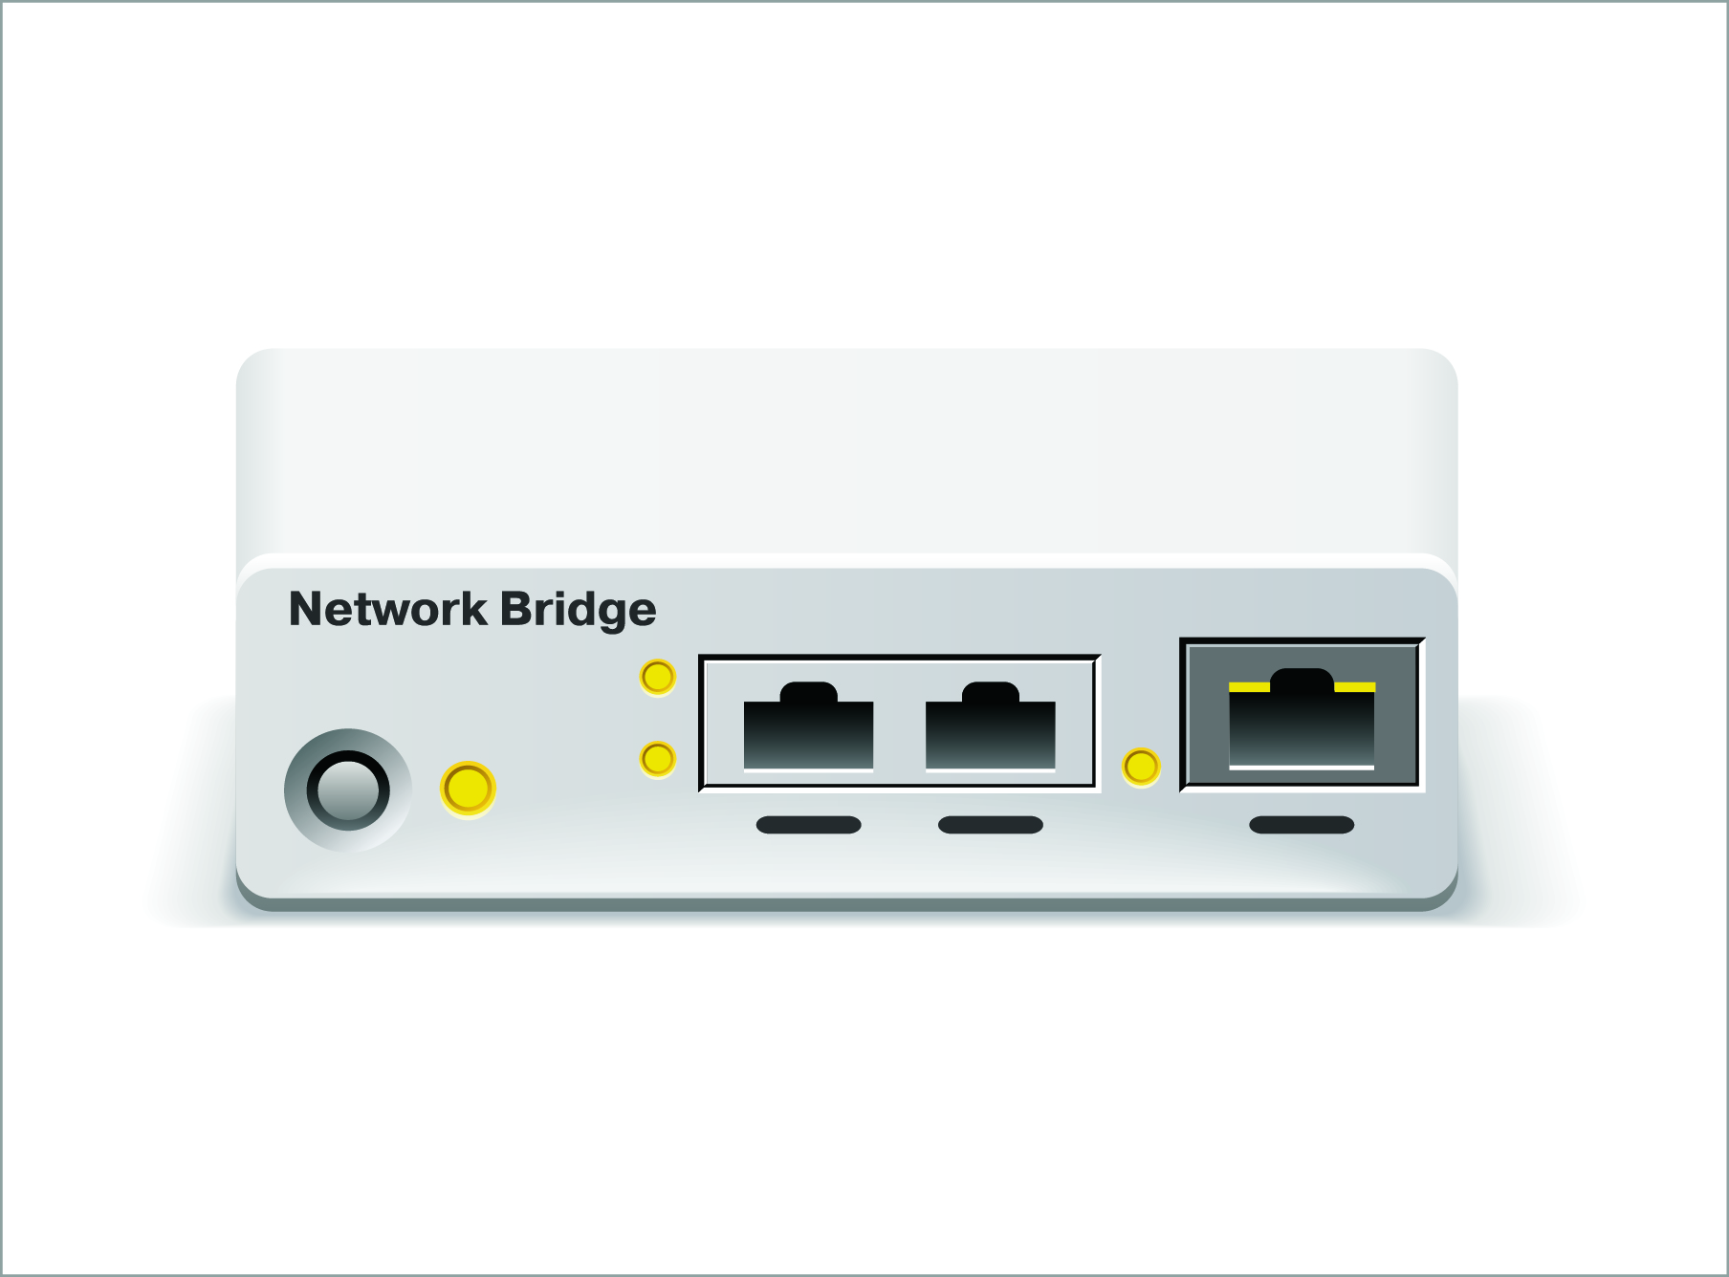
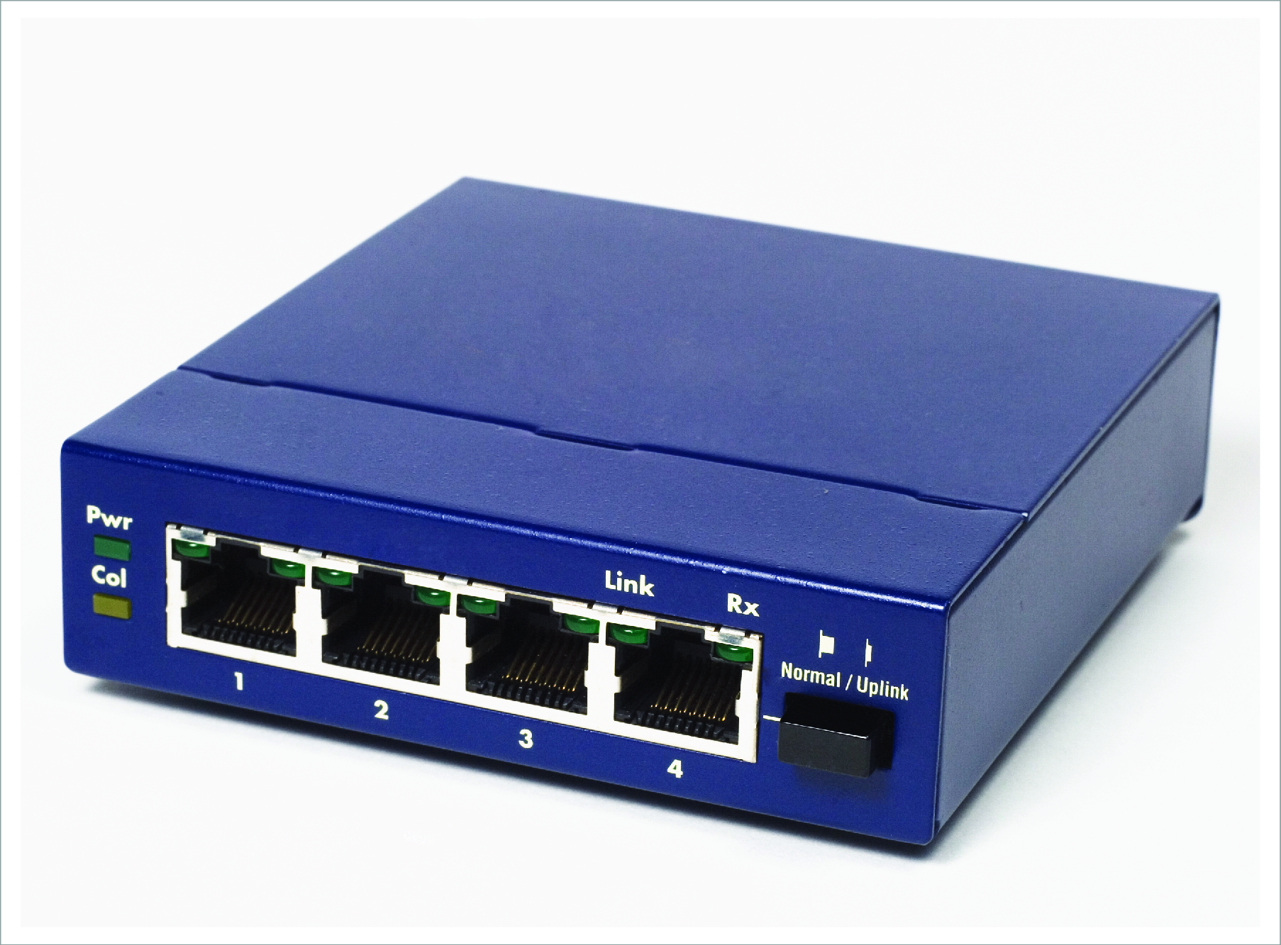
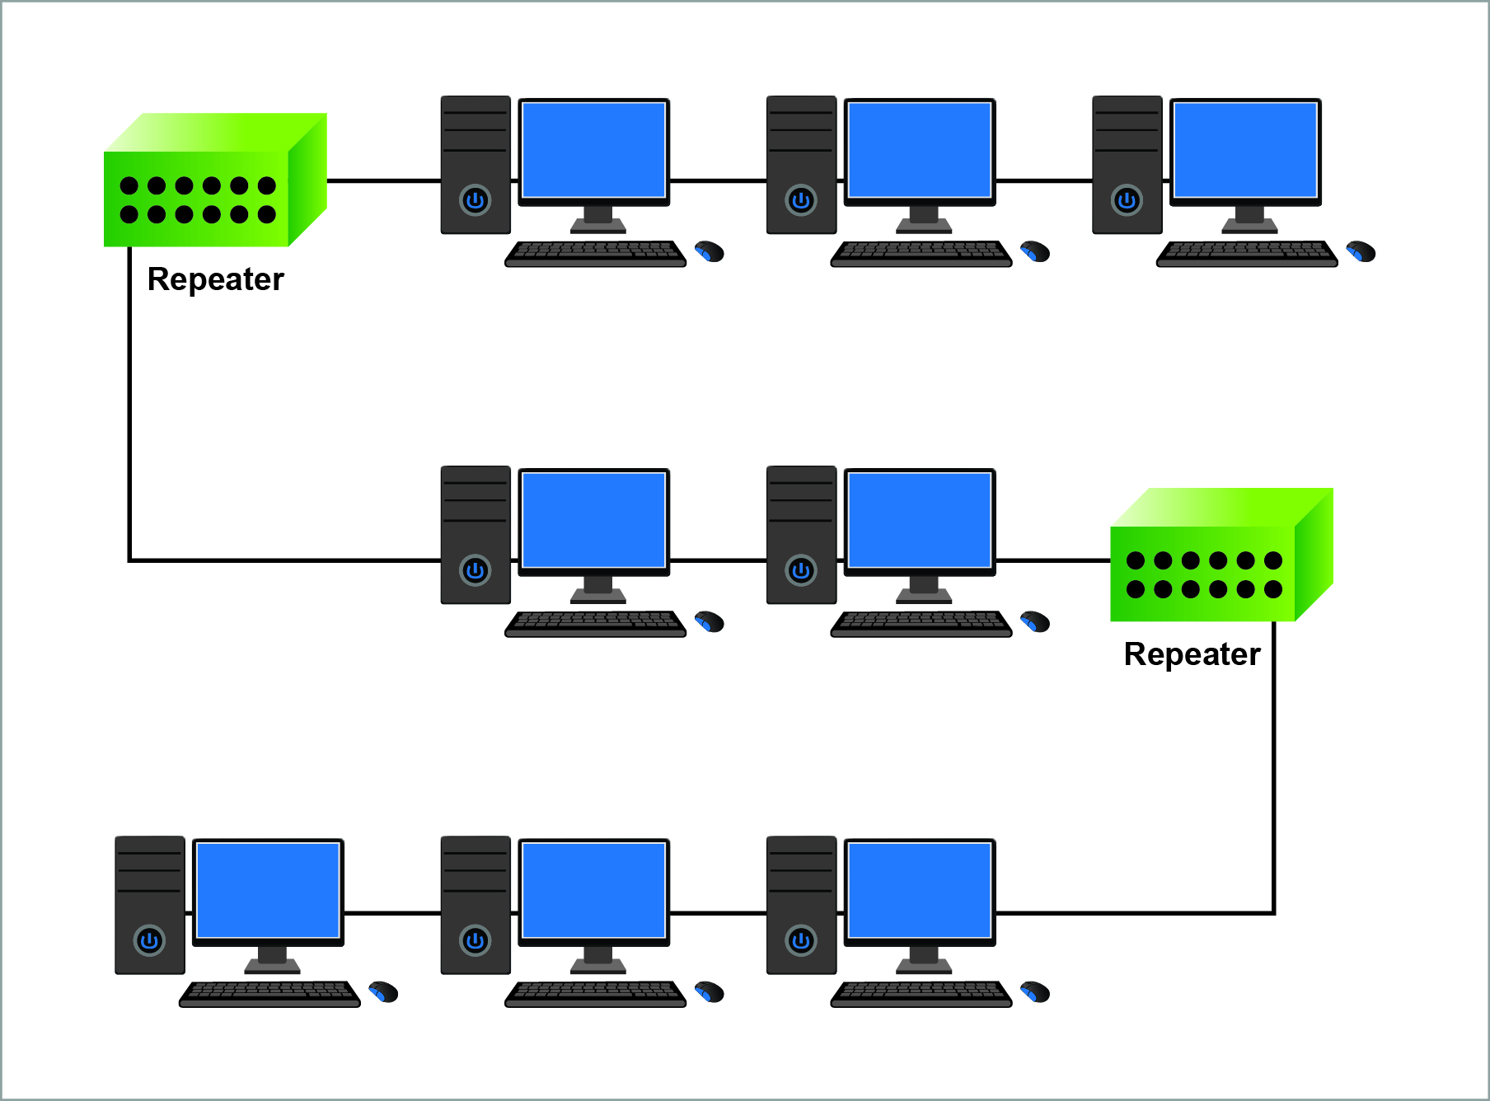
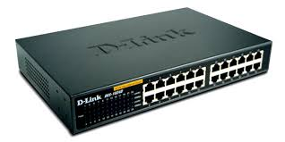
Hub
Bridge
2018
Repeater
Switch

Slide 14
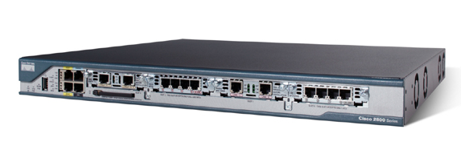
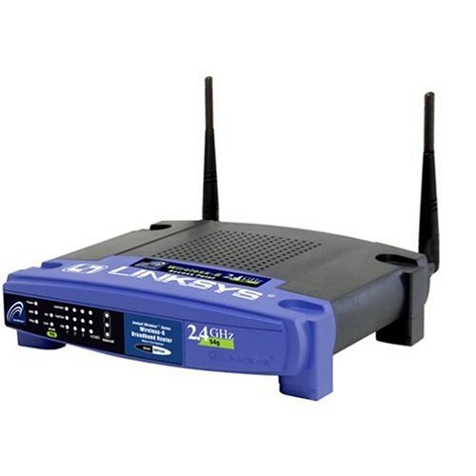
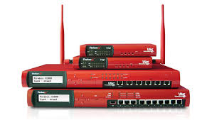
Router
Firewall
Wireless Router

Slide 15

Any Queries
Thank You

